Slide 1

Matthew 7:24-27

Slide 2

The Sermon on the Mount (Matthew 5-7)
Jesus Concludes with a Call to Action (Matt. 7:24-27)!
Sea of Galilee
Northern Shore

Slide 3
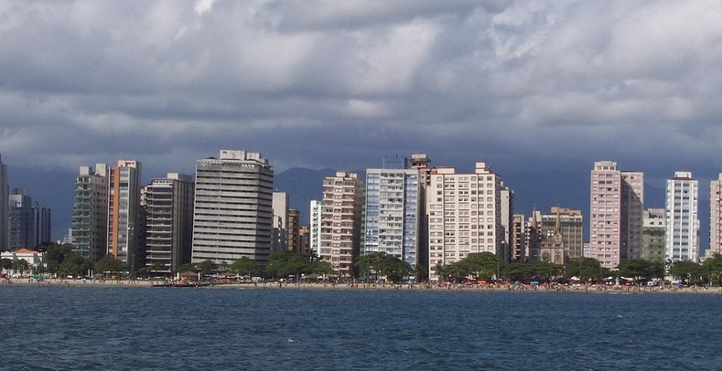
THE IMPORTANCE OF A SOLD FOUNDATION: THE LEANING BUILDINGS OF SANTOS, BRAZIL
Built on an Insecure, Sandy Foundation!
Danger!

Slide 4
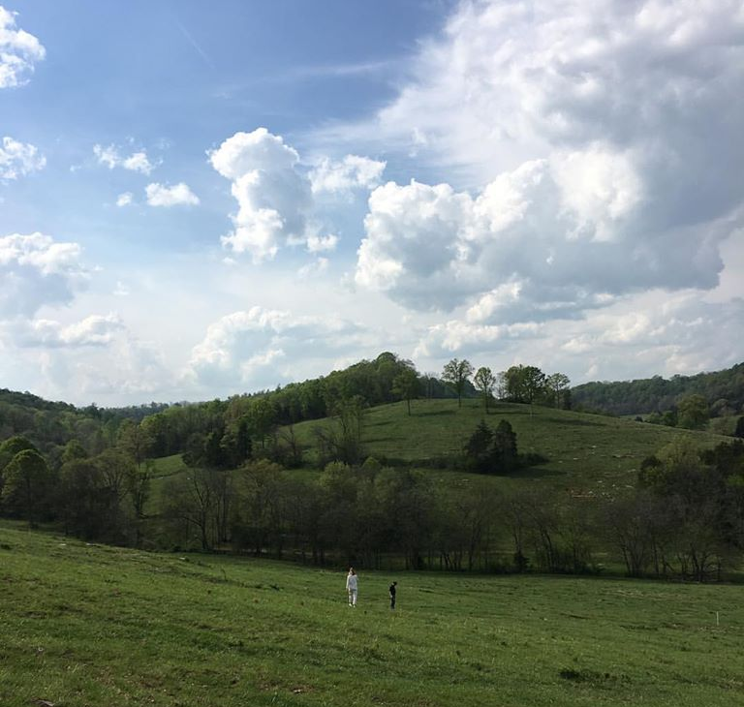
How many have built a house?
We ended up buying a house already built, instead of building one.

Slide 5
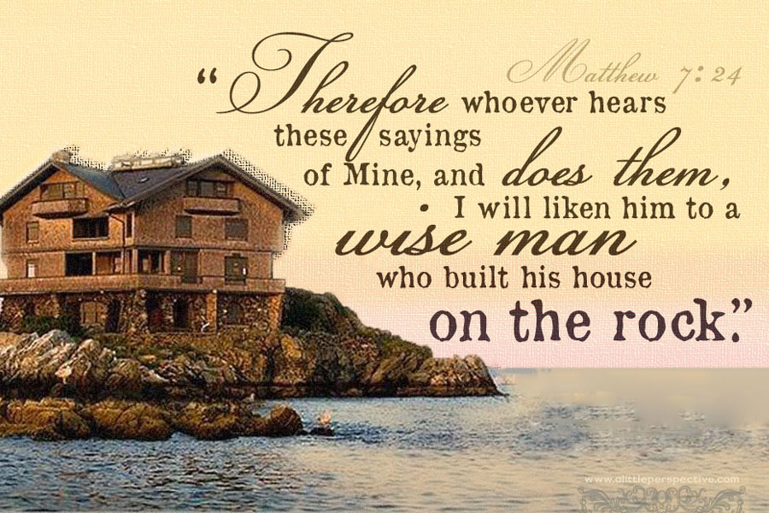
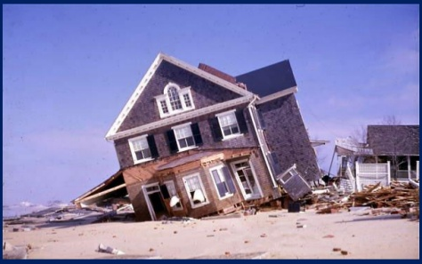
The Wise and Foolish Builders
EVERYONE Must Decide How to Build Their Spiritual Life!

Slide 6
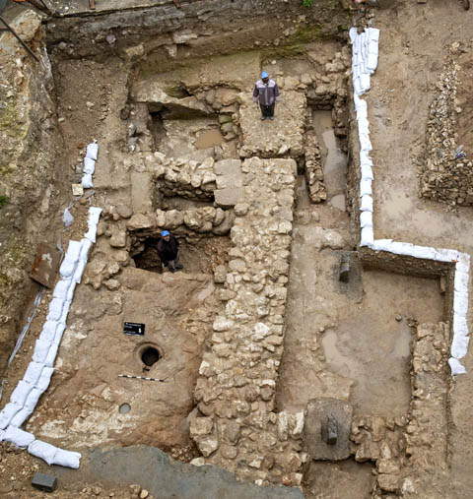
Context of Matt. 7:24-27
Jesus’ Illustration of How to Build
Jesus is talking more about how to build than where (both houses subject to same forces).
Stable house had builder dig down to rock or place rocks as foundation stones. Palestine had sandy, hard-baked soil everywhere.
Unstable house hastily built on sand/dirt, without effort to secure a firm foundation.
Sand=hearing, not obeying. Rock-hearing and obeying Jesus.
Storm=final judgment
Excavation of 1st Century Israelite House
In Nazareth with Rock Foundation

Slide 7
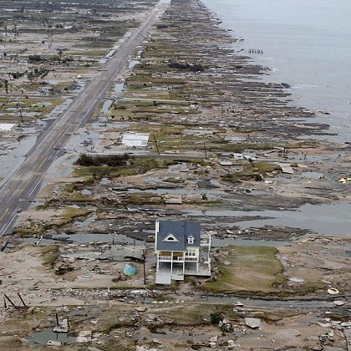
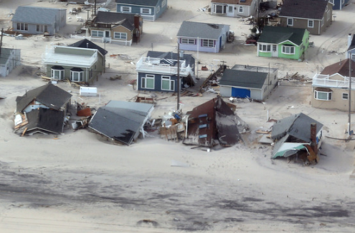
Wisdom is diligent foresight to build on a solid foundation.
Foolishness builds the short-sighted, easy way.
Destroyed homes on a NJ beach after Hurricane Sandy.
Hurricane-proof house after hurricane struck Galveston, TX
Jesus’s words give us the blueprint for building a life that will endure!

Slide 8
1. The Wise Builder
Listens to Jesus with Faith – Matt. 11:15, Gal. 3:2, Rom 10:17, Jn 6:68, 1 Cor. 3:11
Obeys ALL Christ’s Word in Love – Matt. 22:37, Jn 14:15, 1 Jn 5:3

Slide 9
2. The Foolish Builder
Hears but Fails to Act! Why (Mk 4:14-20)?
  Hard heart says “no” to God!
  Shallow heart says “maybe” to God
  Crowded heart says “yes” to God and “yes” to the world
Consequences of disobedience is eternal loss of soul – Matt 7:13-14, 21-23; 25:41-46

Slide 10

The Carpenter from Nazareth can help us build a new life!
“Put off your old self, which belongs to your former manner of life and is corrupt through deceitful desires, and to be renewed in the spirit of your minds, and to put on the new self, created after the likeness of God in true righteousness and holiness” (Eph. 4:22-24).

Slide 11
3. Practical Lessons to Wise Building
Listen in View of Eternity – Jn 12:48, Psa 119:105
  Bible Classes and Sermons – 1 Tim. 3:15, Acts 11:26, Rev. 2:7
  Regular Personal Bible Study – Ja. 1:25, 1 Pet. 2:2
  Memorize, Meditate, Remember during Daily Life – Psa. 119:97, Rom. 12:2

Slide 12
3. Practical Lessons to Wise Building
Resolve to obey Jesus’ Words, even if “hard” (Jn 6:60, Matt 7:14)! For example….
  Love neighbor (everyone), even enemy – Matt. 22:39; 5:44
  Pray for & forgive those who hurt you – Lk 6:28, Matt. 6:14-15
  Deny self and give ALL (not some or most) to Jesus – Lk. 9:23, 14:33, 2 Cor 8:5
  If brother sins, pray for and admonish – Lk 17:3
  Save others, snatching them out of the fire – Ju 23

Slide 13
3. Practical Lessons to Wise Building
Spiritual Benefits of Loving Obedience to Christ!
  Loving Obedience Brings Me Closer to Christ – Jn 14:21,23-24; Matt. 11:28-30
  Obeying Christ Makes Me More Christ-like– Eph 4:12-15; Rom 8:29

Slide 14
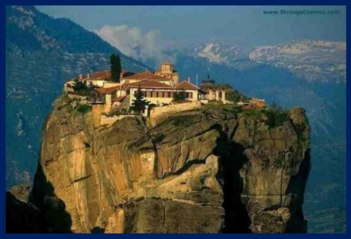
3. Practical Lessons to Wise Building
Spiritual Benefits of Loving Obedience to Christ!
  The loving Christian has the assurance of eternal life with the Lord by His grace! – 1 Jn 2:27-28, 4:17-18, 5:13
House Built on the Rock Jesus Christ
Is the Way to Heaven!

Slide 15
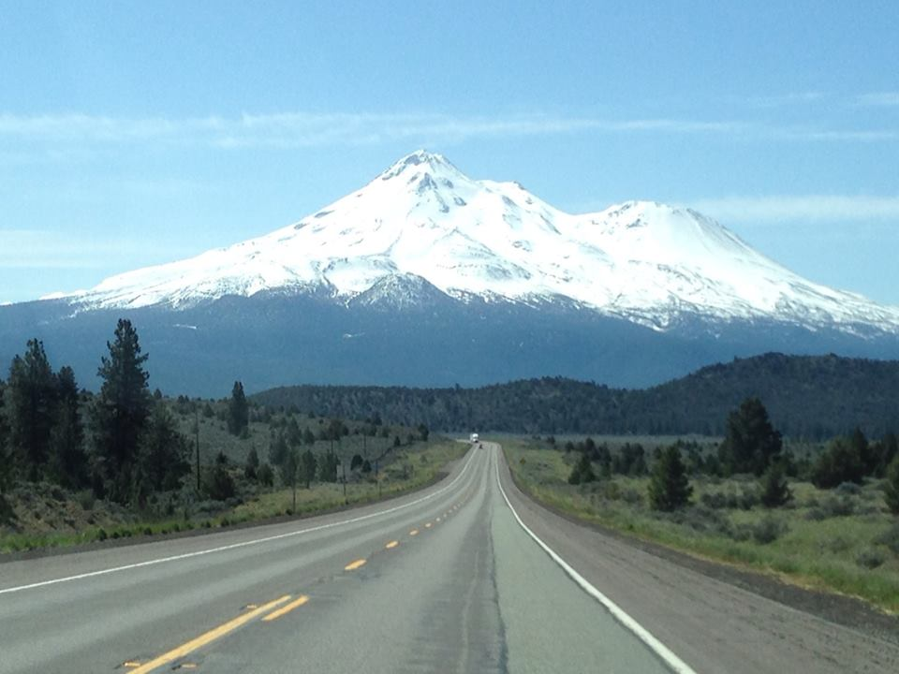
Is what I am doing now going to help me prepare to stand in judgment day?
Jesus is the only rock-solid guide to eternity. All else leads to ruin!

Slide 16
The Wise and Foolish Builders
Everyone Must Decide How to Build Their Life!
LET’S DEDICATE OURSELVES TO FOLLOWING THE WORDS OF THE CARPENTER FROM NAZARETH, WHO HAS PREPARED A MANSION FOR US IN HEAVEN!

Slide 17
The Wise and Foolish Builders
“No one can lay a foundation other than that which is laid, which is Jesus Christ” (1 Cor. 3:11).
“The world is passing away along with its lusts, but
whoever does the will of God abides forever” (1 Jn 2:17).

